Slide 1
R Project – Kaggle Spacecraft
Alfred Nazhiyampara
https://github.com/alfjnaz/R-Project

Slide 2


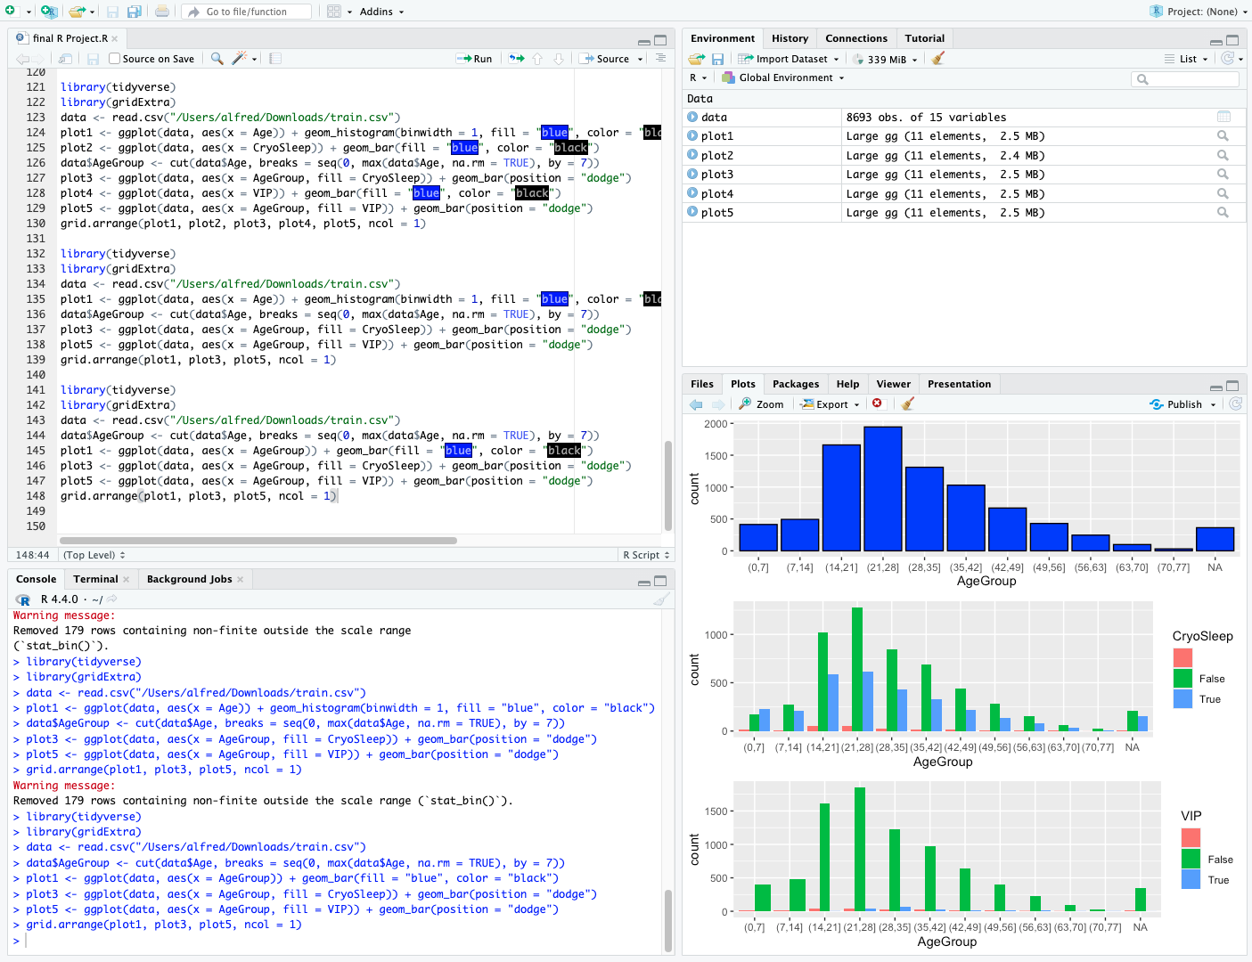
Overview
This is the R Workspace!

Slide 3

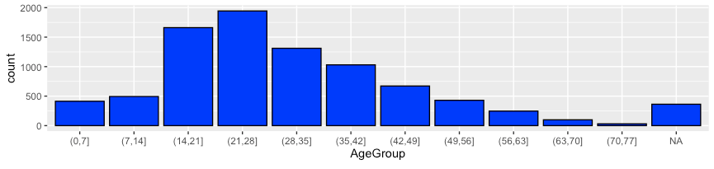
Age Groups - first set of data looked at
The data shows that within age ranges of 7 year spans, the number of people that were on the spaceship
As seen in the data, the most passengers were within the 21-28 year old age range. The data has a bell curve, skewing right

Slide 4
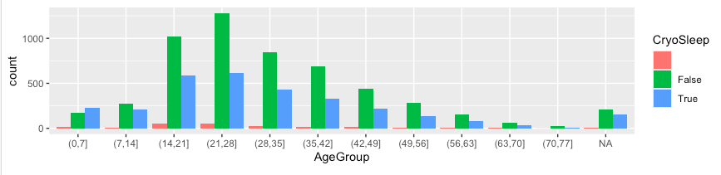
CryoSleep - second set of data looked at
The data shows that within age ranges of 7 year spans, the number of people that that chose CryoSleep on the spaceship
As seen in the data, the most passengers were choosing not to go to CryoSleep, possibly due to cost
There was only one group that chose more CryoSleep than not, the 0-7 age group, possibly since parents may want their children to be quiet and asleep during the flight

Slide 5
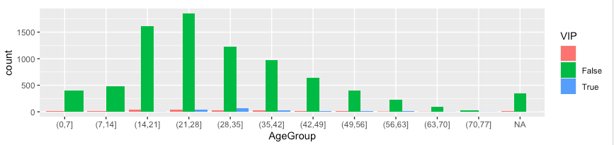
VIP Status - third set of data looked at
The data shows that within age ranges of 7 year spans, the number of people that that chose VIP experience on the spaceship
As seen in the data, the almost all passengers chose not to do the VIP experience, possibly due to cost and lack of additional benefits
The younger groups were not selected for VIP experience possibly because they may be too young to appreciate it, and the group that chose the most VIP was between 28-35, even though not the group with the most passengers

Slide 6
Conclusion
The data analysis reveals interesting patterns about the passengers on the spaceship. The first set of data shows that the majority of passengers were within the 21-28 year old age range, with the data forming a right-skewed bell curve. The second set of data indicates that most passengers opted out of CryoSleep, possibly due to cost considerations. The only exception was the 0-7 age group, where more chose CryoSleep, likely because parents wanted their children to be quiet and asleep during the flight. The third set of data shows that almost all passengers chose not to opt for the VIP experience, possibly due to its cost and lack of additional benefits. Interestingly, the younger groups were not selected for the VIP experience, possibly because they may be too young to appreciate it. The age group that chose the most VIP experience was between 28-35, despite not being the group with the most passengers. This suggests different preferences and decisions across different age groups on the spaceship. To address the Kaggle prompt, it is more likely, based on my analysis of the parameters I looked at, that those who were in CryoSleep and within the 20’s age range which is most represented, may have been transported to the alternate dimension. This did not look at other factors such as planets, which may give more of an accurate prediction.

